Slide 1
Math 152 – Lesson 16
Lesson | Topic | Reading
14 | Improper Integrals | 7.8
15/16 | Work/Ave Value of a Function | 6.4/6.5
17/18 | Applications to Physics & Eng | 8.3
Objectives:
Use integration to calculate the average value of a function

Slide 2
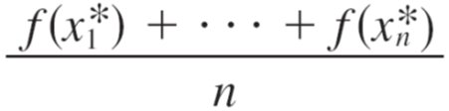
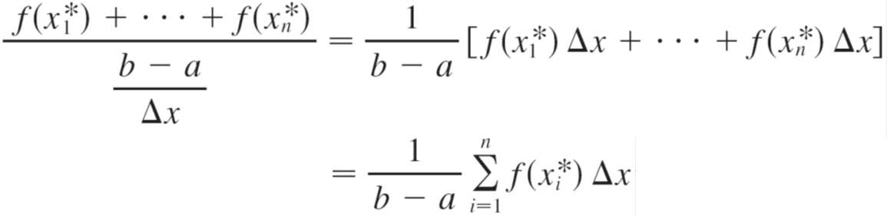
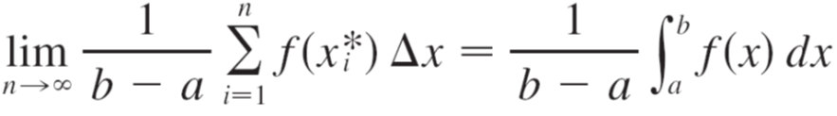

Average of Lots of Numbers
Ave =
but, n = (b – a)/Δx

Slide 3
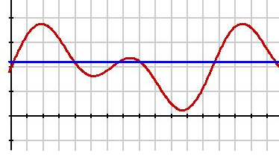
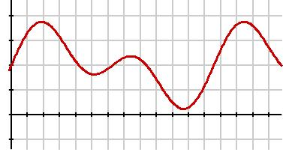
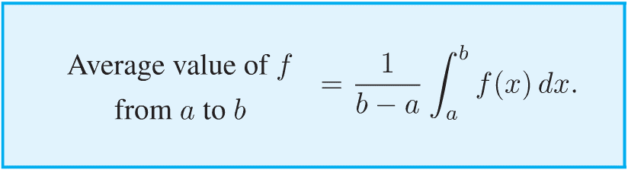


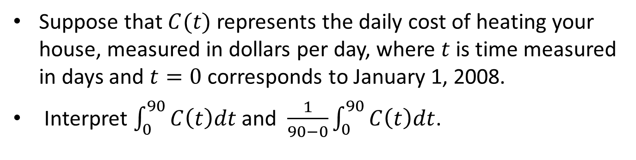
The Definite Integral as an Average
C$(t)$
$$t$$
Suppose that $C(t)$ represents the daily cost of heating your house, measured in dollars per day, where $t$ is time measured in days and $t=0$ corresponds to January 1, 2008.
Interpret $\int_{0}^{90}{C\left(t\right)dt}$ and $\frac{1}{90−0}\int_{0}^{90}{C\left(t\right)dt}$.
Notes:
Total cost of heating the house through March
Average daily cost for first three months

Slide 4
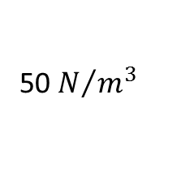
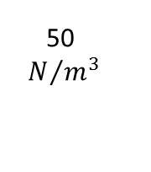
Work Review - Pumping
How much work is required to pump the fuel out of the upper nozzle?
100-h
10 m
10 m
100 m
100 m
50
50
$N/{m^{3}}$
50 m
50 m
50 $N/{m^{3}}$
h
0
Notes:
Slice weight(force) = (volume)(density)= (density)(g)(π$r^{2}$dh)=(50)(π${10}^{2}$dh)
Integrate W = FD = ʃ(50)(π${10}^{2}$dh)from 50 to 100
= 50π$r^{2}$ʃhdh from 50 to 100
= 25π${(10)}^{2}$(${100}^{2}$ - ${50}^{2}$) = 58.9e6 ft lb
----------------------------
r(h) = (a)h + b
r(0) = 10 = 0a + b, b = 10
r(100) = 0 = 100a + 10, a = (-1/10)
r(h) = 10 – h/10
Similar trianges:
10/100 = r/(100-h)
r = .1*(100-h)=1-.1h
Slice weight(force) = (volume)(density)= (π$r^{2}$dh)(50) = 50π${(10 −\frac{h}{10})}^{2}$dh
W = FD = 50πʃh${(10 −\frac{h}{10})}^{2}$dh = 50π(50h^2 – (2/3)h^3 + h^4/400) from 50 to 100
= 50π[50(100^2 – 50^2) – (2/3)(100^3 – 50^3) + (1/400)(100^4 – 50^4)] = 26041.67 ft lb

